Slide 1

LENDING CLUB CASE STUDY
Manasa Manjunath setty
Sridhar vanaparthi

Slide 2
Abstract
Lending club is a market where the needy borrow the loan from investors and repay as per committed time and rate of interest.
There are 2 types of risks associated with this procedure
The applicants who repay the loan on time and the loans are not being sanctioned to such applicants. This leads to loss of business to the company
The applicants who are likely to default and the loans are sanctioned to such applicants. This leads to financial loss to the company.
Hence the company wants to come into conclusion whether to approve or reject the loan application based on certain aspects or features of the applicants.

Slide 3
Methodology used
Data Cleanup
Data Manipulation
Univariate Analysis
Segmented Univariate Analysis
Conclusion
Multivariate Analysis
Bivariate Analysis

Slide 4
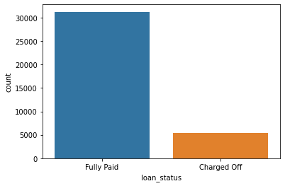
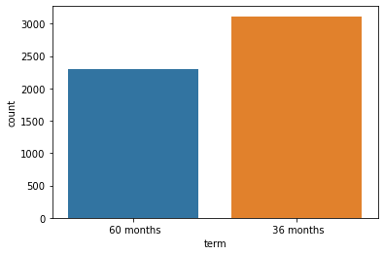
Analysis
LOAN STATUS
This plot clearly shows that count of charged off are comparably less that is around 15% of total applicants
TERM
This plot clearly shows that count of applicants with the term of 36 months are being defaulted high

Slide 5
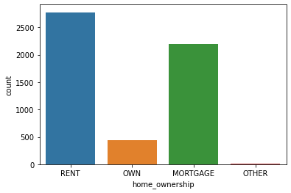
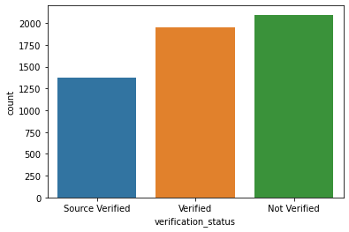
HOME OWNERSHIP
Applicants with Rented House are likely to default, being
being Mortgage the second highest with comparably high
probability
VERIFICATION STATUS
Applicants with non verified status are likely
to default more

Slide 6
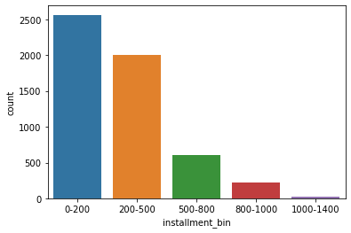
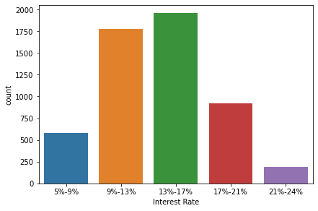
INSTALLMENT
The distribution lies between 0 to 500. However
applicants with installment bin of 0 to 200 are more
likely to default
INTEREST RATE
The distribution lies between 9% to 17%
being highest charge offs in the range of 13% to 17%

Slide 7
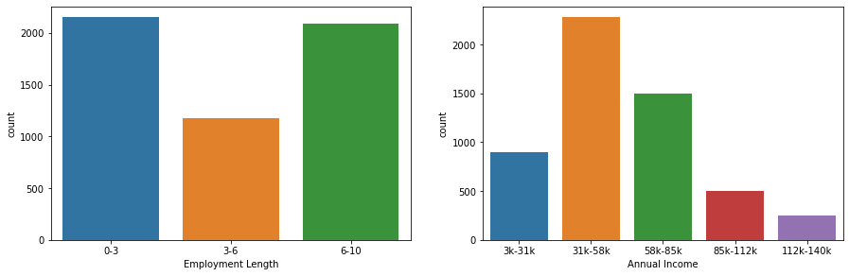
EMPLOYMENT LENGTH
Applicants having experience of 0 to 3 years and 6 to 10 years are likely to default more
ANNUAL INCOME
Applicants with annual income ranging
between 31k and 58k are likely to be Charged-off

Slide 8
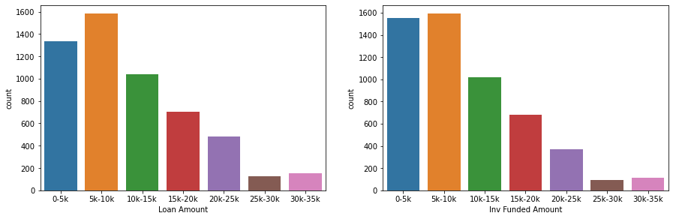
LOAN AMOUNT
Applicants for whom loan amount of 5k to 10k
is sanctioned are more likely to default
FUNDED AMOUNT INV
Applicants who have funded amount inv in
the range of 5k to 10k are defaulted

Slide 9
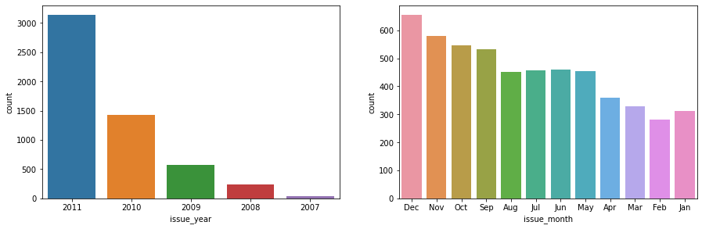
YEAR OF ISSUE
Loans issued in the year 2011 are defaulted
the most
MONTH OF ISSUE
Loans issued in the month of December are
Defaulted the most as per the graph above

Slide 10
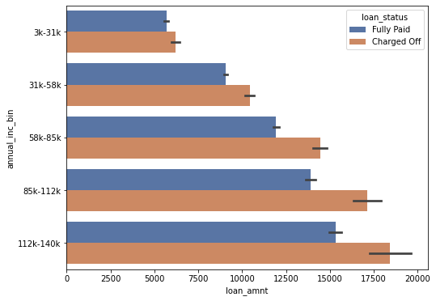
The distribution for the Charged-Off
applicants lies in the range of 85k to
140k of annual income when analyzed
with respect to loan amount, being loan
amount in the range 17500+ being
highest.
Applicants with annual income between
112k to 140k with loan amount of around
18k are likely to default
Loan Amount vs Annual Income

Slide 11
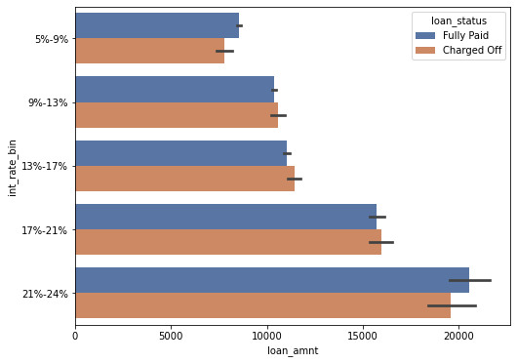
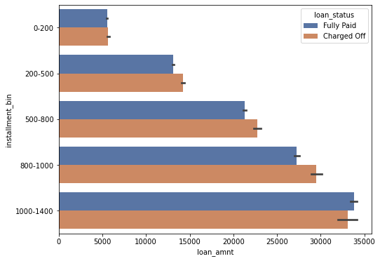
Interest Rate vs Loan Amount
Loans with loan amount of around 20k
And interest rate ranging 21% to 24%
are likely to default
Installment vs Loan Amount
Loans with the amount of nearly 35k
with installment of 1k to 1.4k are
seen to be defaulted

Slide 12
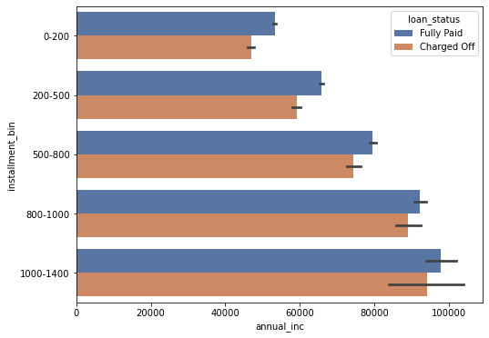
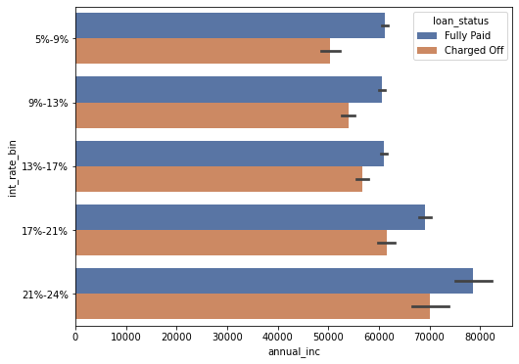
Annual Income vs Installment
Loans of applicants with annual income of around
90k and installment bin in the range 1k to 1.4k are
likely to be Defaulted
Annual Income vs Interest Rate
Loans of applicants with annual income of around
70k and interest bin in the range 21% to 24% are
likely to be Defaulted

Slide 13
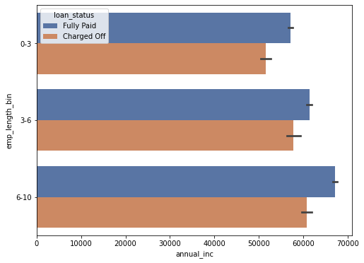
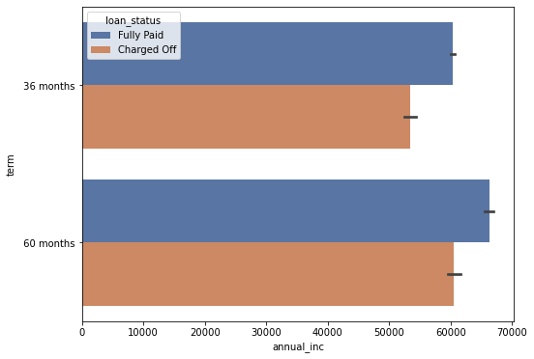
Annual Income vs Emp Duration
Applicants with annual income of 60k
with the work experience of 3 to 10 years
are likely to default
Annual Income vs Term of Loan
Applicants with annual income of 60k
with the Term of 60 months are likely to default
Similarly, loans of 36 months duration
Sanctioned for applicants having annual
income of 50k are likely to default

Slide 14
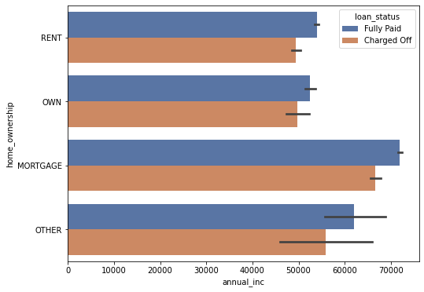
The distribution seems to be high between 60k
to 70k of annual income and for the applicants
with Mortgaged property
Applicants with annual income of around 70k
having mortgaged property are likely to default
more as per the analysis
Annual Income vs Home Ownership

Slide 15
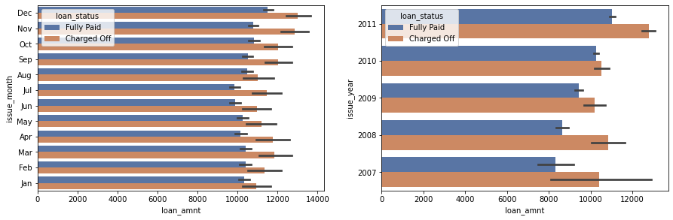
Loan Amount vs Month of Issue
Loans issued in the month of Nov and Dec
with the loan amount of 12k to 14k are likely
defaulted
Loan Amount vs Year of Issue
Loans issued in the year of 2011with the loan
amount of greater than 12k likely
defaulted

Slide 16
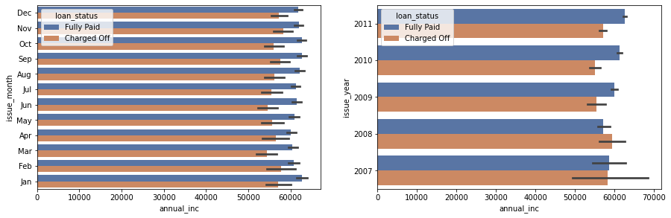
Annual Income vs Month of Issue
Loans issued in the month of Nov, Dec, Jan
and Feb with the annual income of 50k to 60k are
likely defaulted
Annual Income vs Month of Issue
Loans issued in the year of 2007, 2008 and
2011 with the annual income of 50k to 60k
are likely defaulted

Slide 17
CONCLUSION
The major factors to be considered during approval of loan are
Annual Income
Employment Duration
Term of Issue
Interest Rate
Installment
Further analysis are available in the graphs drawn which needs to be considered before approval

